Slide 1
Locators
NashTech
July 2022

Slide 2
What is locator?
Locator Types
How to get a good locator?
Q&A
Agenda

Slide 3
Locator
1. What is Element Locator?
- Element Locator is an address of a UI element. (The By object represents the Element Locator in Selenium WebDriver)`.
Ex: By.Xpath(“//button”).
2. Why we need Element Locator?
- It helps Selenium WebDriver to find and interact with page’s element.
Ex: Webdriver.Click(<locator>)

Slide 4

Capture Locator
There are 8 ways to locate Element. Accordingly, they are grouped to 3 locating technics.
By.Id()
By.Name()
By.ClassName()
By.TagName()
By.LinkText()
By.PartialLinkText()
By.CssSelector()
By.XPath()
Our task is to seek the corresponding value for each locating way from the HTML page source.
1. Element’s attributes
2. CSS Selector
3. XPath

Slide 5
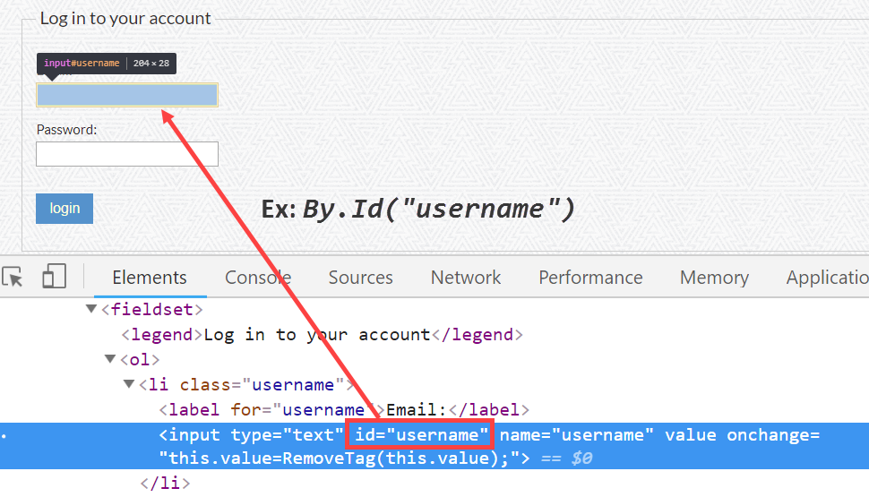
Using UI Element’s ID
Notes:
This is the straightforward way to locate an element.
Be aware of auto-generated ID since it will break your locator.
There are few cases that the UI Element’s ID is duplicated/not unique, you should alert developer and find another way to locate the element.

Slide 6
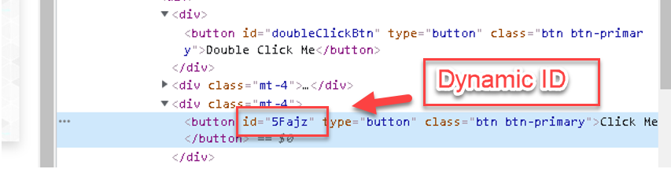
Using UI Element’s ID
Notes:
This is the straightforward way to locate an element.
Be aware of auto-generated ID since it will break your locator.
There are few cases that the UI Element’s ID is duplicated/not unique, you should alert developer and find another way to locate the element.

Slide 7
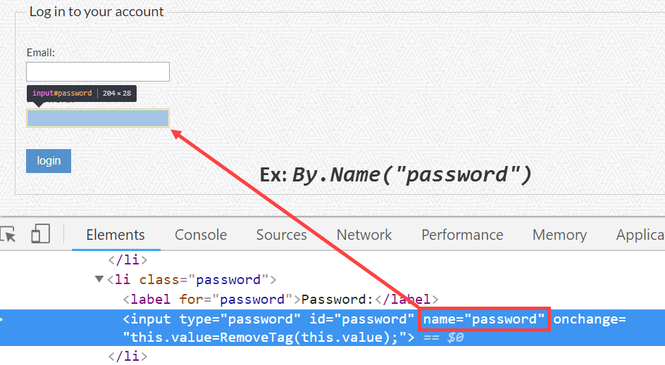
Using UI Element’s Name
Notes:
If ID does not exist, you can use Name instead.
Be also aware of auto-generated Name since it will break your locator.
There are few cases that the UI Element’s Name is duplicated/not unique, you should alert developer and find another way to locate the element.

Slide 8
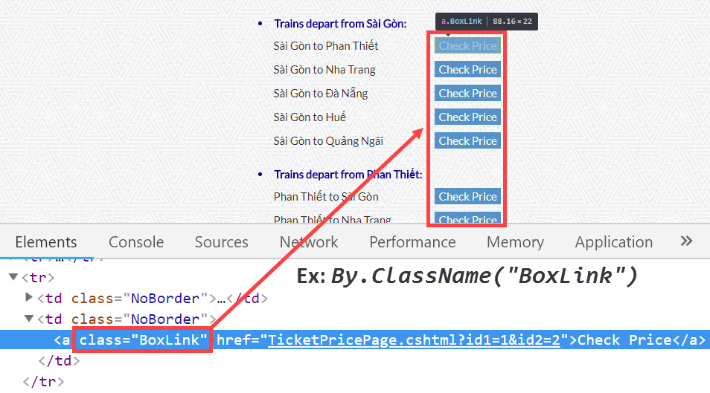
Using UI Element’s Class Name
Notes:
Class name can be used to find a group of UI Elements.
Class name is usually modified due to layout changes. Thus, it is not a stable value to rely on.

Slide 9
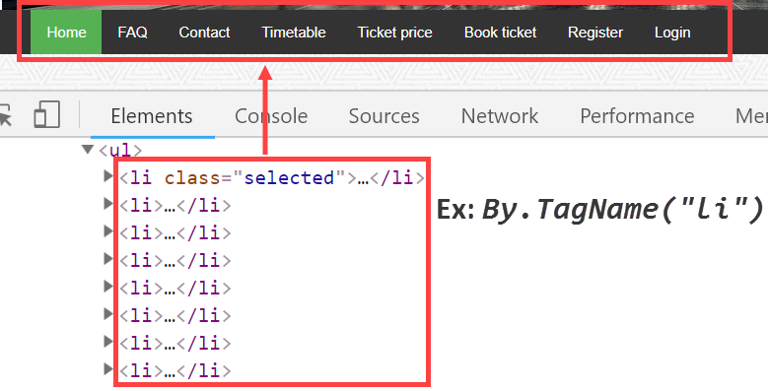
Using UI Element’s Tag Name
Notes:
Tag name is usually used to find a group of similar UI Elements.
Tag name can not be changed so it is quite stable.

Slide 10
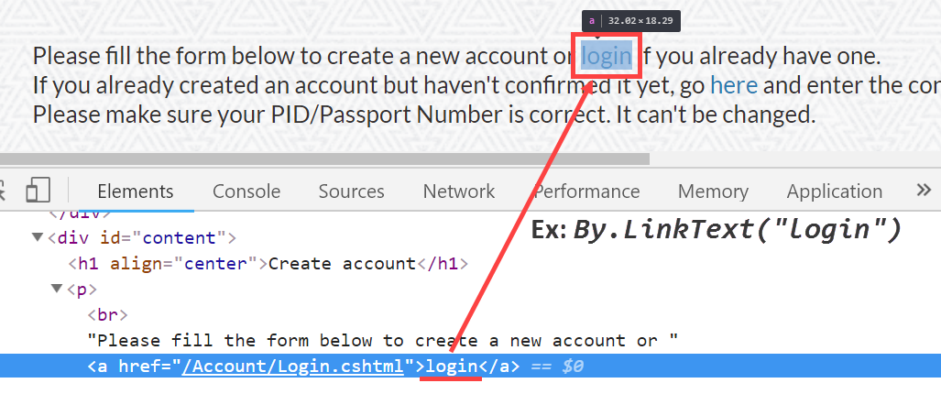
Using UI Element’s Link Text
Notes:
Used to locate UI Element which is link (<a></a>) using its display text.
Locating UI Element using its text is not referable because text will be changed due to localization.

Slide 11
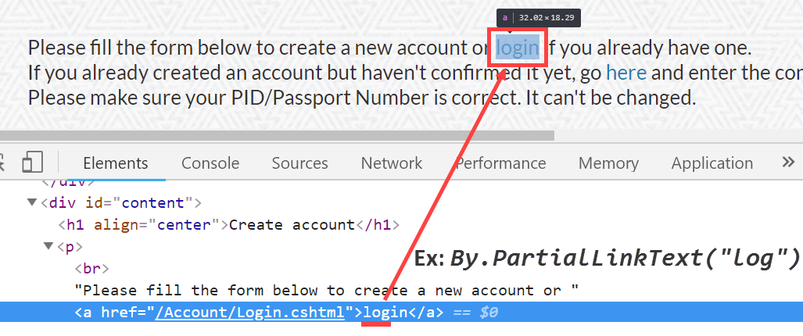
Using UI Element’s Partial Link Text
Notes:
Similar to Link Text but Partial Link Text requires just a part of the full display text.
It might result multiple matching UI Elements.

Slide 12
Practice for Element’s attributes
<input required="" autocomplete="off" pattern="\d*" minlength="10" maxlength="10" placeholder="Mobile Number" type="text" id="userNumber" class=“form-control“ name=“user”>
Answer:
By.Id(“userNumber”)
By.Name(“user”)
By.ClassName(“form-control”)
<a id="simpleLink" href="https://demoqa.com" target="_blank">Home</a>
Answer:
By.Id(“simpleLink”)
By.LinkText(“Home”)
By.PartialLinkText(“Hom”)
By.TagName(“a”)
Notes:
Similar to Link Text but Partial Link Text requires just a part of the full display text.
It might result multiple matching UI Elements.

Slide 13
Using CSS Selector
What is CSS?
Answer: CSS defines how HTML elements are to be displayed.
What is CSS Selector?
Answer: In CSS, selector is pattern used to select the UI element(s).
Common Syntax: By.CssSelector("<CSS_Selector>")
Example: By.CssSelector("input.submitbtn")

Slide 14
Using CSS Selector
Selector | Example | Example description
.class | .intro | Selects all elements with class="intro"
#id | #firstname | Selects the element with id="firstname"
* | * | Selects all elements
element | p | Selects all <p> elements
element, element | div, p | Selects all <div> elements and all <p> elements
element element | div p | Selects all <p> elements inside <div> elements
element > element | div > p | Selects all <p> elements where the parent is a <div> element
element + element | div + p | Selects all <p> elements that are placed immediately after <div> elements
element1 ~ element2 | p ~ ul | Selects every <ul> element that are preceded by a <p> element
[attribute] | [target] | Selects all elements with a target attribute
[attribute=value] | [target=_blank] | Selects all elements with target="_blank"
[attribute~=value] | [title~=flower] | Selects all elements with a title attribute containing the word "flower"

Slide 15
Using CSS Selector
Selector | Example | Example description
[attribute|=value] | [lang|=en] | Selects all elements with a lang attribute value starting with "en"
[attribute^=value] | a[href^="https"] | Selects every <a> element whose href attribute value begins with "https"
[attribute$=value] | a[href$=".pdf"] | Selects every <a> element whose href attribute value ends with ".pdf"
[attribute*=value] | a[href*="w3schools"] | Selects every <a> element whose href attribute value contains the substring "w3schools"
:first-child | p:first-child | Selects every <p> element that is the first child of its parent
:last-child | p:last-child | Selects every <p> element that is the last child of its parent
:not(selector) | :not(p) | Selects every element that is not a <p> element
:nth-child(n) | p:nth-child(2) | Selects every <p> element that is the second child of its parent
:nth-last-child(n) | p:nth-last-child(2) | Selects every <p> element that is the second child of its parent, counting from the last child

Slide 16
Using CSS Selector
A CSS Selector can be a combination of multiple CSS Selectors.
A bit faster than XPath in some cases (in milliseconds) but slower than the Attribute technic.
Lacking of arithmetic, logical operator and function support as compare to XPath.

Slide 17
Pratice for CSS Selector
<input required="" autocomplete="off" pattern="\d*" minlength="10" maxlength="10" placeholder="Mobile Number" type="text" id="userNumber" class=“form-control“ name=“user”>
Answer:
By.CssSelector(“#userNumber”)
By.CssSelector(“.form-control”)
By.CssSelector(“input[name=‘user’]”)
By.CssSelector(“input[placeholder=‘Mobile Number’]”)
<a id="simpleLink" href="https://demoqa.com" target="_blank">Home</a>
Answer:
By.CssSelector(“#simpleLink”)
By.CssSelector(“a[href=‘https://demoqa.com’]”)
Notes:
Similar to Link Text but Partial Link Text requires just a part of the full display text.
It might result multiple matching UI Elements.

Slide 18
Using XPath
What is XPath?
XPath stands for XML Path Language
XPath uses "path like" syntax to identify and navigate nodes in an XML document
XPath contains over 200 built-in functions
XPath is a major element in the XSLT standard
XPath is a W3C recommendation
Common Syntax: By.XPath("<XPath_Expression>")
Example: By.XPath("//input[@id=‘username’]")

Slide 19
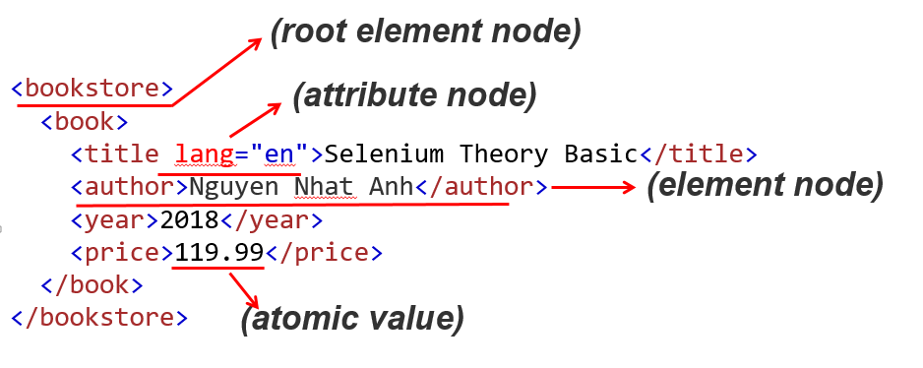
Using Xpath
Relationship of Nodes
Parent
Children
Siblings
Ancestors
Descendants
Examples:
The bookstore node is the parent of book node. Each node has only one parent.
The title, author, year, and price elements are all siblings.

Slide 20
Using Xpath
Useful Path Expressions
Expression | Description
/ | Selects from the root node
// | Selects nodes in the document from the current node that match the selection no matter where they are
. | Selects the current node
.. | Selects the parent of the current node
@ | Selects attributes

Slide 21
Using Xpath
Useful Operators
Operator | Description | Example
= | Equal | price=9.80
!= | Not equal | price!=9.80
< | Less than | price<9.80
<= | Less than or equal to | price<=9.80
> | Greater than | price>9.80
>= | Greater than or equal to | price>=9.80
or | or | price=9.80 or price=9.70
and | and | price>9.00 and price<9.90

Slide 22
Using XPath
Useful Axes
AxisName | Example | Result
ancestor | ancestor::div | Selects all ancestors (parent, grandparent, etc.) of the current node
ancestor-or-self | ancestor-or-self::button | Selects all ancestors (parent, grandparent, etc.) of the current node and the current node itself
attribute | attribute::class | Selects all attributes of the current node
child | child::a | Selects all children of the current node
descendant | descendant::span | Selects all descendants (children, grandchildren, etc.) of the current node
descendant-or-self | descendant-or-self::button | Selects all descendants (children, grandchildren, etc.) of the current node and the current node itself
following | following::div | Selects everything in the document after the closing tag of the current node
following-sibling | following-sibling::div | Selects all siblings after the current node
parent | parent::table | Selects the parent of the current node
preceding | preceding::td | Selects all nodes that appear before the current node in the document, except ancestors, attribute nodes and namespace nodes
preceding-sibling | preceding-sibling::td | Selects all siblings before the current node

Slide 23
Using XPath
Useful built-in functions
Function name | Signatures | Summary
contains | contains($arg1 as xs:string?, $arg2 as xs:string?) as xs:boolean | Returns true if the string $arg1 contains $arg2 as a substring, taking collations into account.
starts-with | starts-with($arg1 as xs:string?, $arg2 as xs:string?) as xs:boolean | Returns true if the string $arg1 contains $arg2 as a leading substring, taking collations into account.
ends-with | ends-with($arg1 as xs:string?, $arg2 as xs:string?) as xs:boolean | Returns true if the string $arg1 contains $arg2 as a trailing substring, taking collations into account.
normalize-space | normalize-space() as xs:string | Returns the value of $arg with leading and trailing whitespace removed, and sequences of internal whitespace reduced to a single space character.
count | count($arg as item()*) as xs:integer | Returns the number of items in a sequence.
text | text() as xs:string | Returns the value of $arg which is the text of the node.

Slide 24
Using XPath
Let’s analyze some XPaths
XPath | Explanation
/html/body/div/div//div[@id='menu']/ul/li/a/span[text()='Login'] | Absolute path
//*[@id="menu"]/ul/li[8]/a | Using node index and wildcard (*)
//a[@href='/Account/Login.cshtml'] | Using attribute
//a[contains(@href, 'Contact')] | Using function
//a[contains(@href, 'Contact')]/../following-sibling::li | Using function and axes
//a[@href='/Account/Login.cshtml' and text()='login'] | Useful Operators

Slide 25
Using XPath
Never use absolute path.
Better avoid using wildcard (*) which will slow down the execution.
Avoid using node index since it's not a stable property.
Avoid capturing by text with multiple language site
Rely on stable attributes.
Use ' (single-quote) rather than " (double-quote)
The shorter, the better

Slide 26
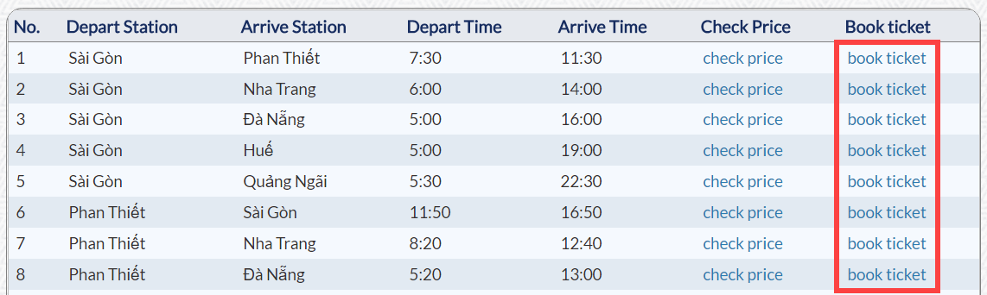
Dynamic locator
How many locators would you think you will have for the highlighted links?
Example:
//td[text()='<depart_station>']/following-sibling::td[text()='<arrive_station>']/..//a[contains(@href, 'Book')]

Slide 27
Dynamic Locator
Dynamic Locator is the one which helps to catch more than one similar UI Elements having the same XPath syntax. By flexibly changing only the data but keep the syntax, we can leverage the power of Dynamic Locator.
Example:
//td[text()='<depart_station>']/following-sibling::td[text()='<arrive_station>']/..//a[contains(@href, 'Book')]
Notices:
Dynamic Locator can reduce significantly the number of code line for similar controls. Thus, reduce the pressure in the maintain phase later on.
Use it wisely! It might lead to complex code.

Slide 28
Pratice for Xpath
<input required="" autocomplete="off" pattern="\d*" minlength="10" maxlength="10" placeholder="Mobile Number" type="text" id="userNumber" class=“form-control“ name=“user”>
Answer:
By.Xpath(“//input[@id=‘userNumber’]”)
By.Xpath(“//input[@class=‘form-control’]”
By.Xpath(“//input[@name=‘user’]”)
By.Xpath(“//input[@placeholder=‘Mobile Number’]”)
<a id="simpleLink" href="https://demoqa.com" target="_blank">Home</a>
Answer:
By.Xpath(“//a[text()=‘Home’]”)
By.Xpath(“//a[@href=‘https://demoqa.com’]”)
Notes:
Similar to Link Text but Partial Link Text requires just a part of the full display text.
It might result multiple matching UI Elements.

Slide 29
What makes a good locator?
The locator must match the desired element
The locator must not match any other element
Avoid depending on information that is likely to change
Depend on the minimal necessary information
Locators still work after you change the UI elements around the element you target

Slide 30
Summary
There are three technics to locate UI Element
Using Element’s attributes
CSS Selector
XPath
Our task is to seek the corresponding value for each locating way from the HTML page source

Slide 31
Exercise
Use Chrome Developer Tools to get ID, CSS, XPATH
Jira003: [PRACTICE] - Get Selenium locators (ID, CSS and XPATH)
Deadline: 10 July 2022
Link: https://gitlab.com/company-training/rookies-batch5/batch5/-/issues/3
Jira004: [FINAL] - Get Selenium locators (ID, CSS and XPATH)
Deadline: 12 July 2022
Link: https://gitlab.com/company-training/rookies-batch5/batch5/-/issues/4

Slide 32
URL References - Element Locators in Selenium
https://www.guru99.com/locators-in-selenium-ide.html
https://www.guru99.com/xpath-selenium.html
https://www.w3schools.com/cssref/css_selectors.asp
http://www.cheat-sheets.org/saved-copy/Locators_table_1_0_2.pdf (*)
https://saucelabs.com/resources/articles/selenium-tips-css-selectors

Slide 33

Notes:
What is Automation Test
Test automation Pros and Cons
Automation testing level/layer
What is Shift Left Testing, how automation involve
What is Shift Right testing, how automation involve

Slide 34


